Slide 1
Financial Math
Topic: Profit and Loss
EQ: How do we work out profit and loss?

Slide 2

Last Lesson Recap
Marcus buys a bike for $500 and sells it a year later for 20% less. What is the sale price?

Slide 3
Profit and Loss Formulas
Sell price – cost price = Profit or Loss?
If it is a Negative number;
Then you sold an item for less than you paid for it, it means you made a loss.
If it is a Positive number;
Then you sold an item for more than you paid for it you have made a profit
LHS - For each of the following
a) is this a profit or a loss.
b) How much is the profit or loss
Mark sold a car for $4,500 after buying it for $6,500 the year before.
Julie bought an antique sewing machine for $200 which she restored and sold for $750.
Andrew bought an Remote control car for $110. He sold it on gumtree for $150.

Slide 4


Topic: Profit and Loss
EQ: How do we work out profit and loss?
In business it is often necessary to find out what percentage profit or loss is made on an item.
$$Percentage Loss=\frac{Loss in \$}{Cost Price}×100$$
$$Percentage Profit=\frac{profit in \$}{Cost Price}×100$$
Lets now find the % profit or loss for each of these.
Mark sold a car for $4,500 after buying it for $6,500 the year before.
Julie bought an antique sewing machine for $200 which she restored and sold for $750.
Andrew bought an Remote control car for $110. He sold it on gumtree for $150.

Slide 5
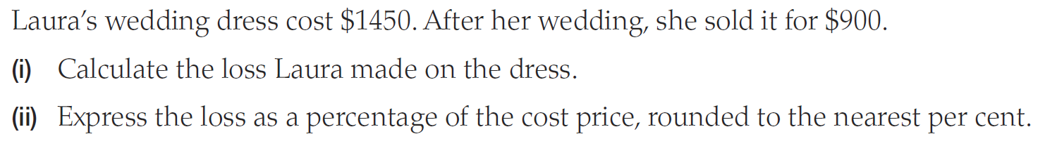

How to Calculate Loss
$$Percentage Loss=\frac{Loss in \$}{Cost Price}×100$$

Slide 6
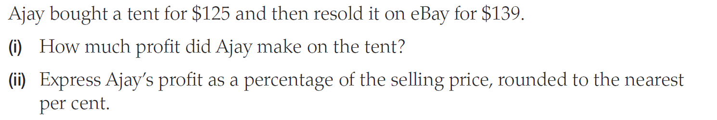

How to Calculate Profit
$$Percentage Profit=\frac{profit in \$}{Cost Price}×100$$

Slide 7
If I can manufacture toy cars at a cost of $3 and sell them for $5, What is my profit and my percentage profit?
If I can manufacture a fountain pen at a cost of $25 and sell it for $35, What is my profit and my percentage profit?
Which item is more profitable for me to manufacture?

Slide 8


Slide 9
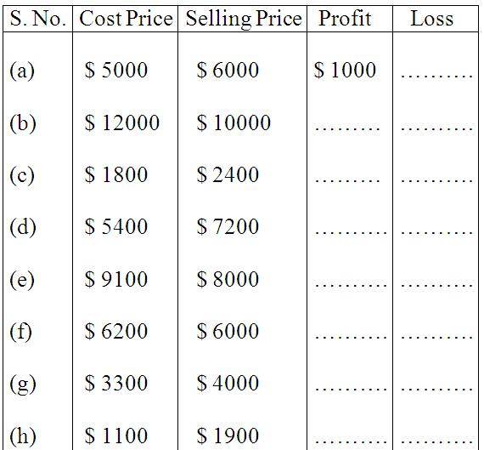
Worksheet
Notes:
a.

Slide 10
A TV was bought for $ 18,950 and sold at a loss of $ 4780. Find the selling price.
A second-hand car was sold for $ 190,000, at a loss of $ 85. Find the CP of the car.
Jane sold her genset for $ 20000 at a profit of $ 1737. Find the CP of genset.

Slide 11
Abraham bought a music system for $ 6375.00 and spent $ 75.00 on its transportation He sold it for $ 6400.00. Find his profit or loss percent.
Joy bought pens at $ 120 a dozen. He sold it for $ 15 each. What is his profit percent?
Simi bought a study table for $ 9000. She sold it at a profit of 20%. How much profit did she make? What is the selling price?

Slide 12
Find the selling price if the cost price is $ 1200 and loss percent is 25.
Marshall bought 20 refills and sold them at $ 4 each. If it had cost $ 50 for the refills, what was his profit or loss percent?
Mr. Smith buys pencils at $ 250 per hundred and sells each at $ 1.75. Find his loss or profit.

